Slide 1
Amy Ertan
Royal Holloway University London

Slide 2
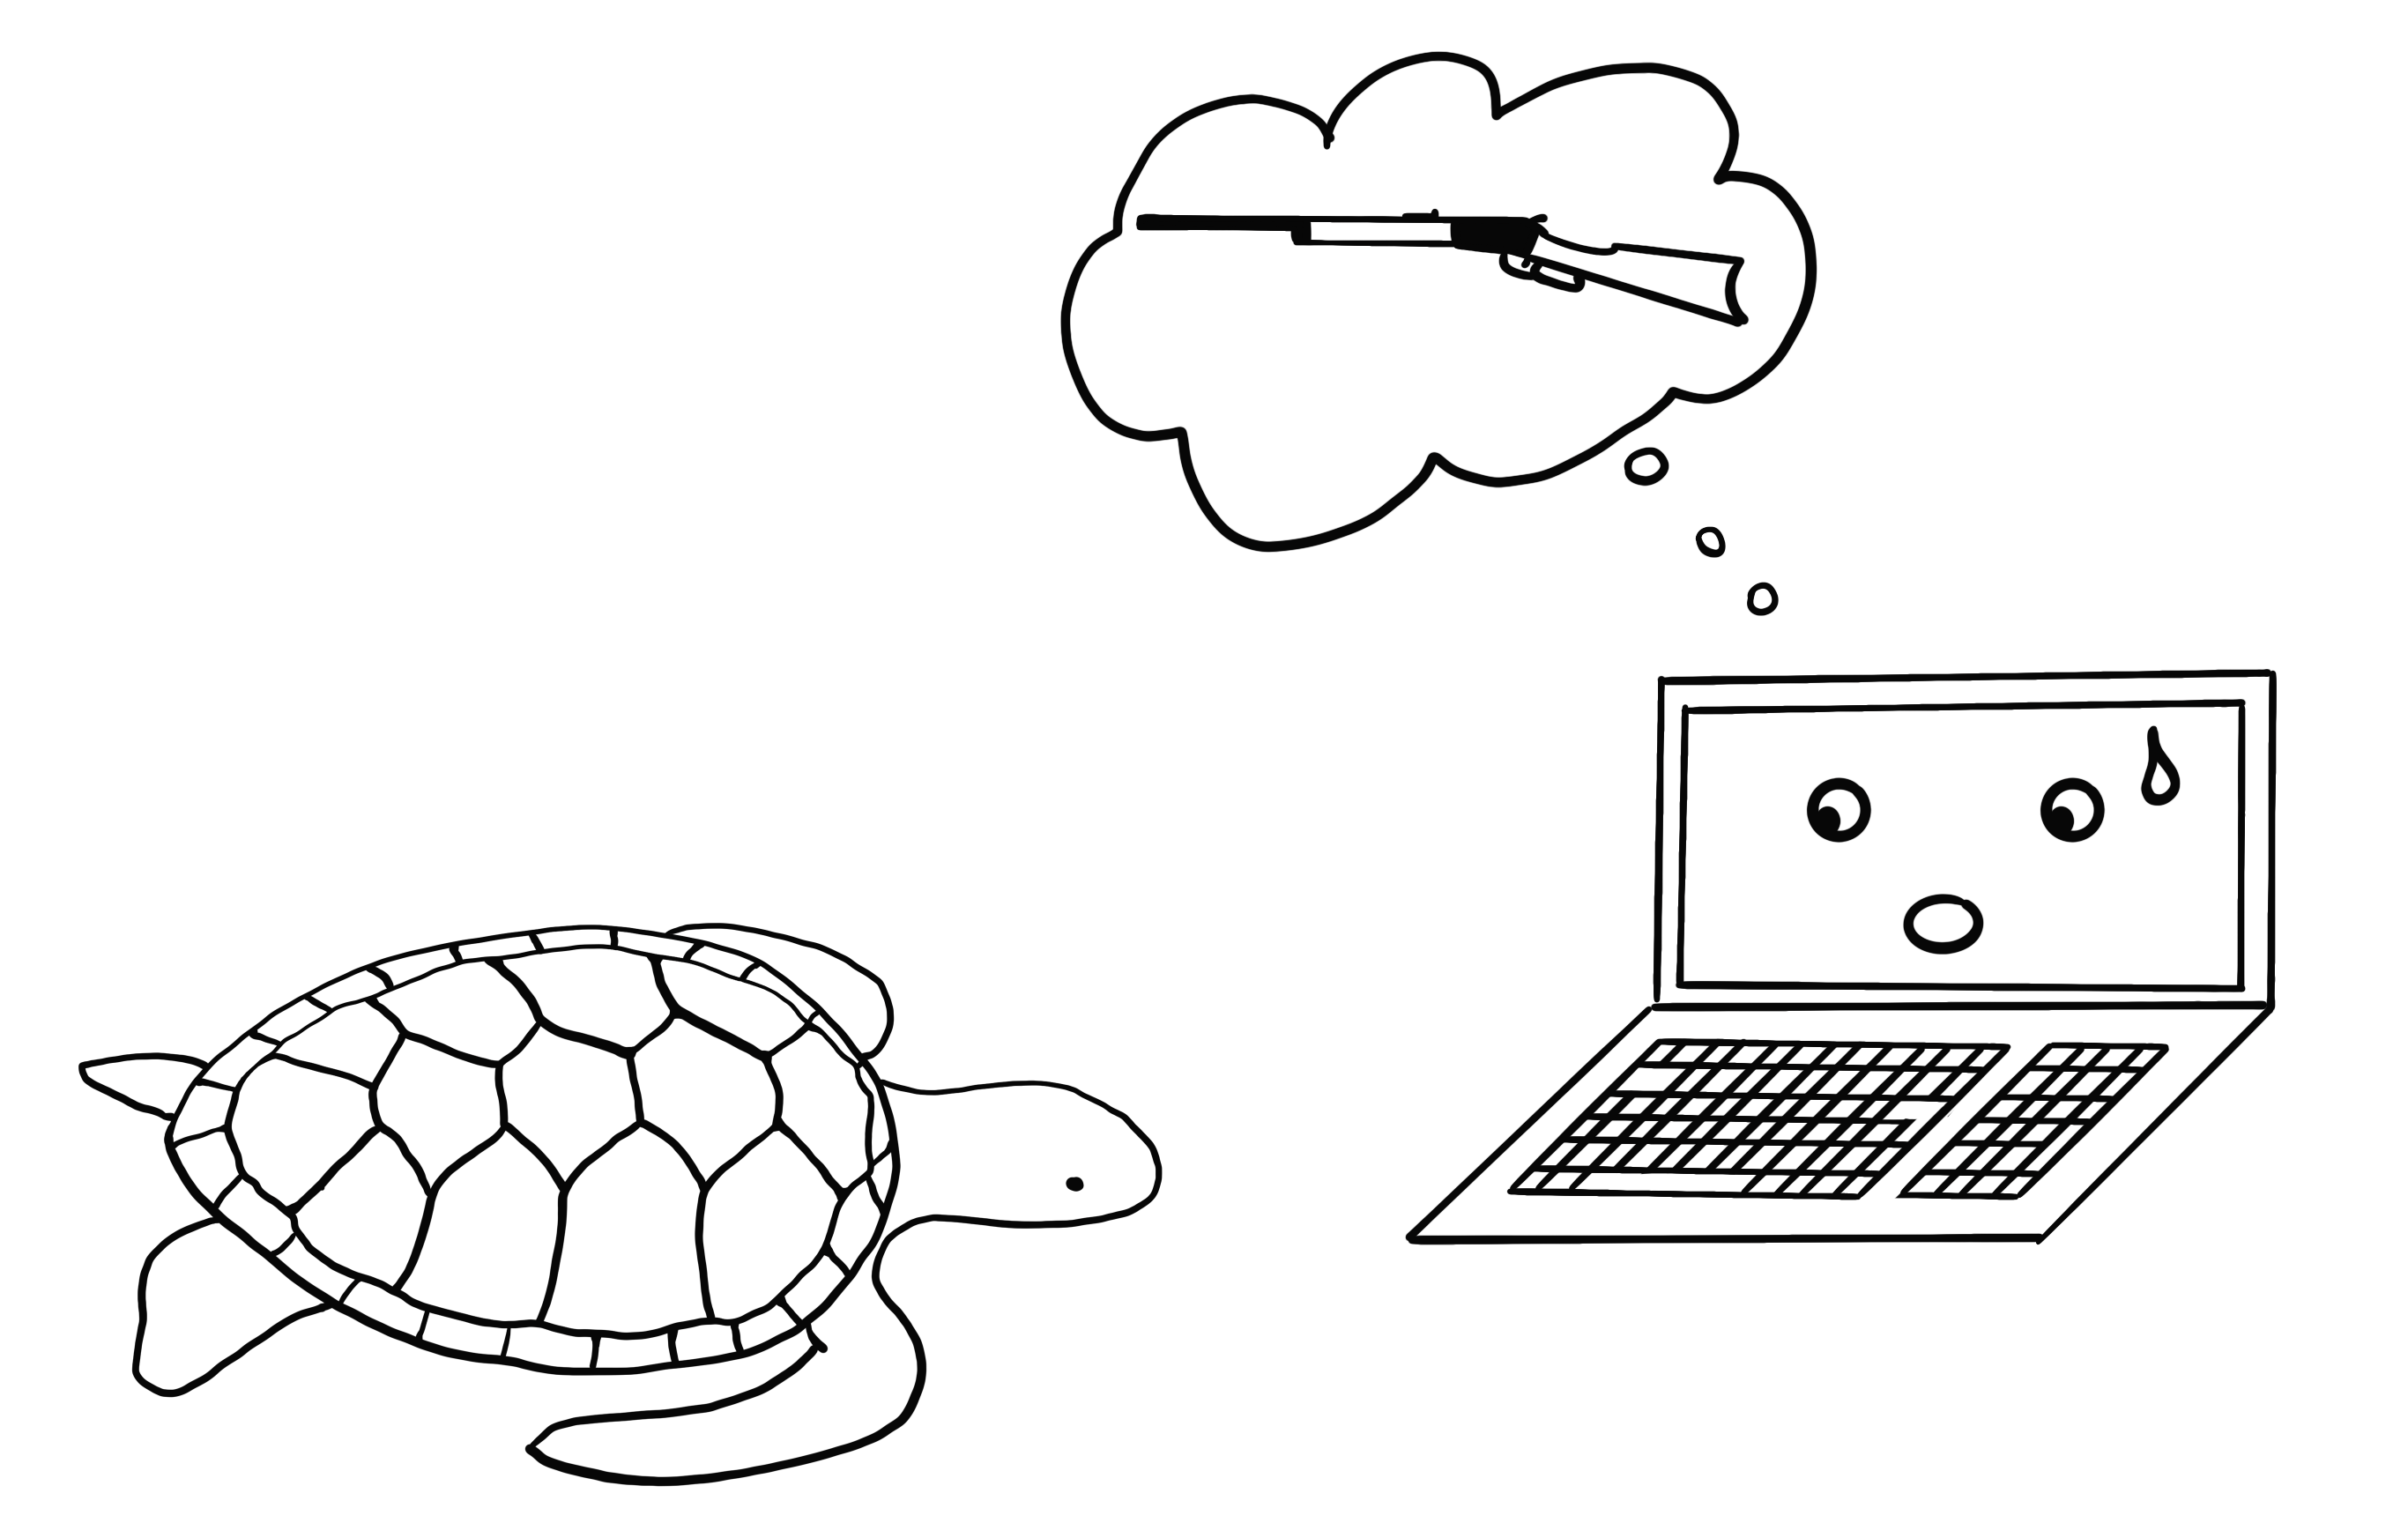
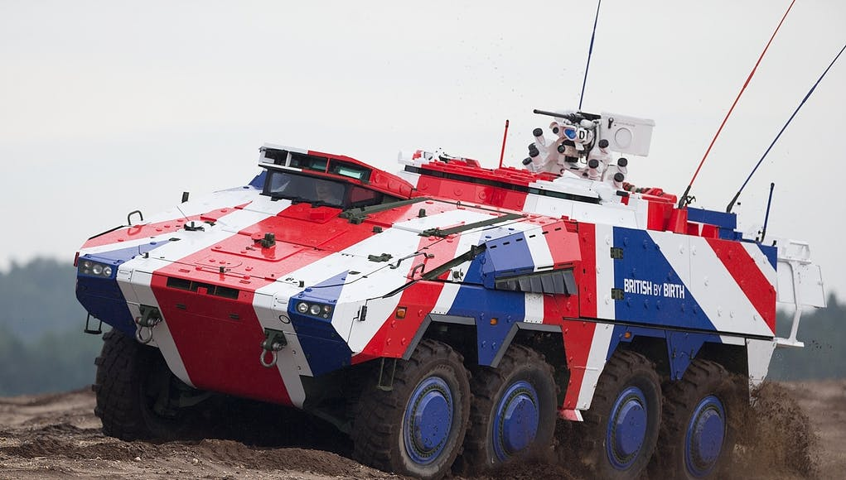
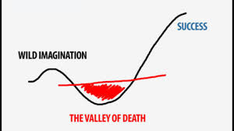
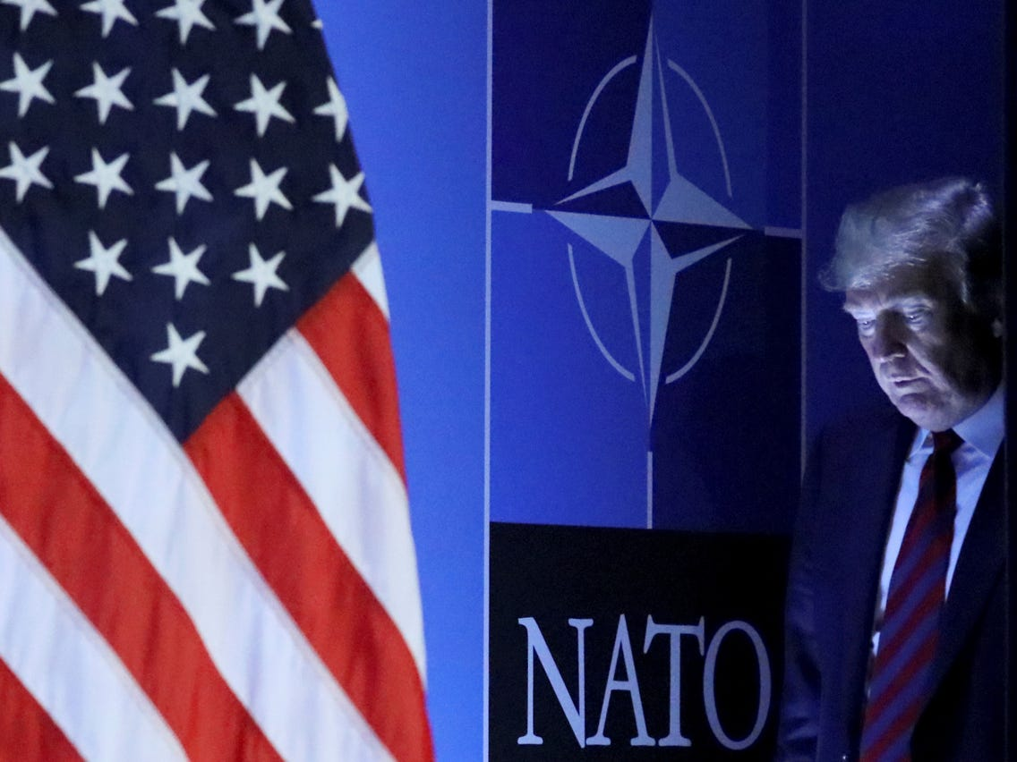
The Security Implications of AI-enabled Technology in the Military
1
2
3
CLICK TO START
9
3
4
5
6
7
8
10
11
12
13
14
15
16
17
18
19
20
21
22
23
24
25
26
27
28
29
1
30
2
(1) So WHAT?
(2) Exploring approaches
(3) Findings to date
mins
mins
mins
secs
secs
secs
secs
secs
secs
secs
secs
secs
secs
secs
secs
secs
secs
secs
secs
secs
secs
secs
secs
secs
secs
secs
secs
secs
secs
secs
secs
secs
secs
@AmyErtan www.amyertan.com

