Slide 1
The utility of gait in forensic human identification: an empirical investigation using biomechanical and anthropological principles.
Ioana Macoveciuc
Department of Security and Crime Science

Slide 2
JUSTIFICATION
Is progress being made in forensic gait analysis?
Gait Research
Clinical
Gait Analysis
Forensic Gait Analysis
Gait Recognition
Automated (computer vision)
To what extent can gait analysis be used in identification?

Slide 3
JUSTIFICATION
1. What are the strengths and weaknesses of forensic gait analysis methods?
Weaknesses
Technical
Environment
The individual
Algorithm performance
Shadows
Clothing
2. Is there a pattern to these strengths and weaknesses?
Poor camera quality
Lighting
Shoes
Obstacles
Demographic characteristics
Walking surface
Other moving objects

Slide 4
AIMS
To better understand the relationship between form (anatomy) and function (physiology) of normal human gait,
To investigate the biomechanical basis for gait uniqueness by examining similarities and differences in joint angles, and,
To build upon current theoretical foundations of gait-based human identification.

Slide 5
DATASET
Figure 1 – KIT Marker Set-up Protocol
 | Mandery, C., Terlemez, O., Do, M., Vahrenkamp, N. and Asfour, T. 2015. The KIT Whole-Body Human Motion Database. International Conference on Advanced Robotics (ICAR), 27-31 July 2015. Istanbul, Turkey. pp. 329 – 336. https://h2t.anthropomatik.kit.edu/pdf/Mandery2015a.pdf (accessed October 16, 2020).

Slide 6
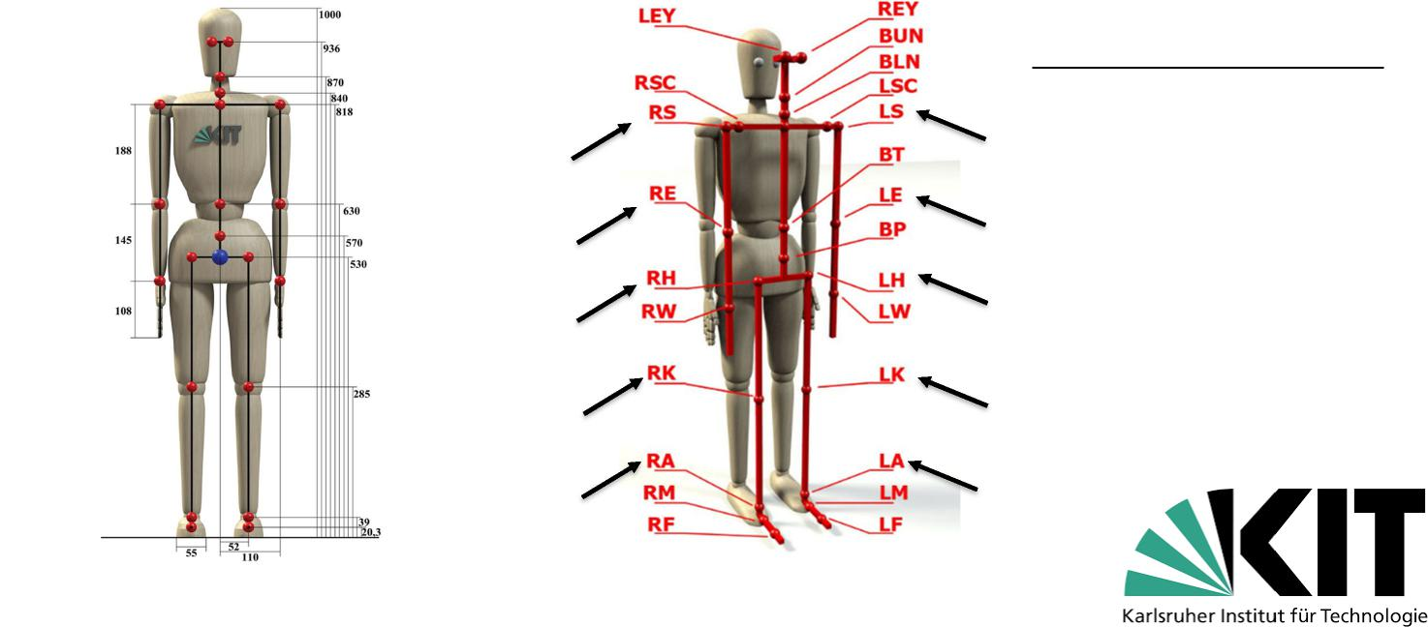
DATASET
Figure 2 – The KIT MMM Model Figure 3 –Annotated MMM Model
The joints of interest for this study were:
RS/LS – right/left shoulder
RE/LE – right/left elbow
RH/LH – right/left hip
RK/LK – right/left knee
RA/LA – right/left ankle
Mandery, C., Terlemez, O., Do, M., Vahrenkamp, N., and Asfour, T. 2016. Unifying representations and large-scale whole-body motion databases for studying human motion. IEE Transactions on Robotics, 32(4):796-809.
Terlemez, O., Ulbrich, S. and Mandery, C. 2014. Master Motor Map (MMM) – Framework and toolkit for capturing, representing, and reproducing human motion on humanoid robots. IEEE-RAS International Conference on Humanoid Robots (Humanoids). 18-20 November. Madrid, Spain. https://h2t.anthropomatik.kit.edu/pdf/Terlemez2014.pdf (accessed April 25, 2020).

Slide 7
RESULTS
Gait Utility in Identification
Intraindividual Variability |  | Interindividual Variability
Are characteristics of singular |  | How large are differences |  | Does the degree of intraindividual |  | Do differences between body
gait cycles represented in their |  | amongst gait cycles of the |  | variability influence differentiation |  | sides influence differentiation
respective mean waveforms? |  | same participant? |  | amongst individuals? |  | amongst individuals?
 | Shape |  | Standard Deviation |  | Fisher-pitman permutation tests
Synchronicity
Angle Values

Slide 8
RESULTS
Gait Utility in Identification
 |  | Interindividual Variability
Intraindividual Variability
Are characteristics of singular |  | How large are differences |  | Does the degree of intraindividual |  | Do differences between body
gait cycles represented in their |  | amongst gait cycles of the |  | variability influence differentiation |  | sides influence differentiation
respective mean waveforms? |  | same participant? |  | amongst individuals? |  | amongst individuals?
 |  |  |  |  | Fisher-pitman permutation tests
 | Shape |  | Standard Deviation
Synchronicity
Angle Values

Slide 9
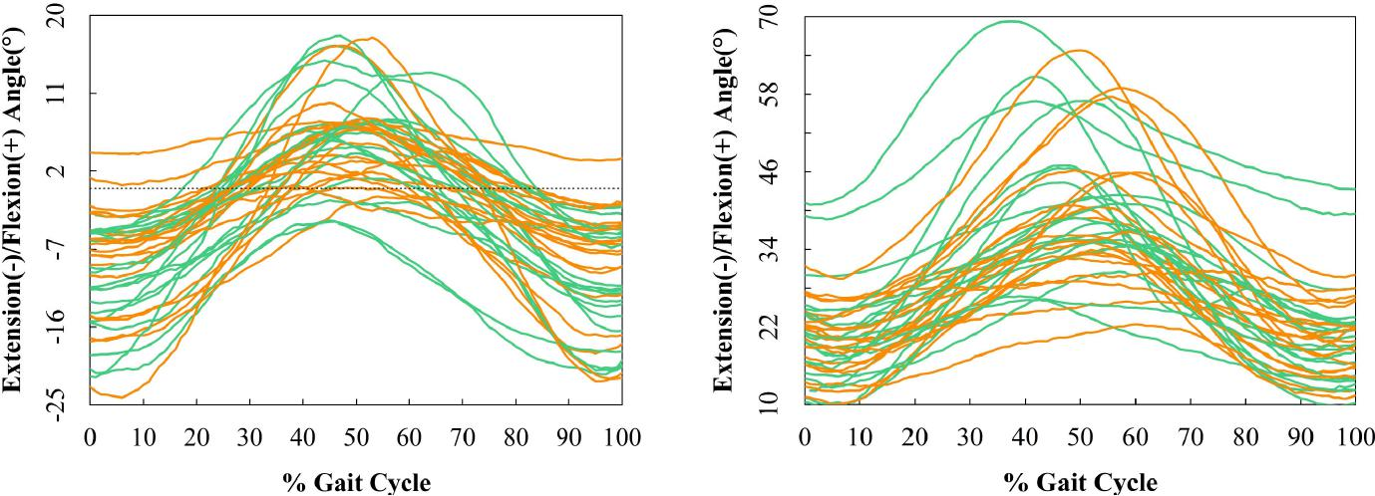
Intraindividual Variability: Upper Body Joints
A - Shoulder Joint B - Elbow Joint
Figure 4 – Upper Limb Angular Waveforms

Slide 10
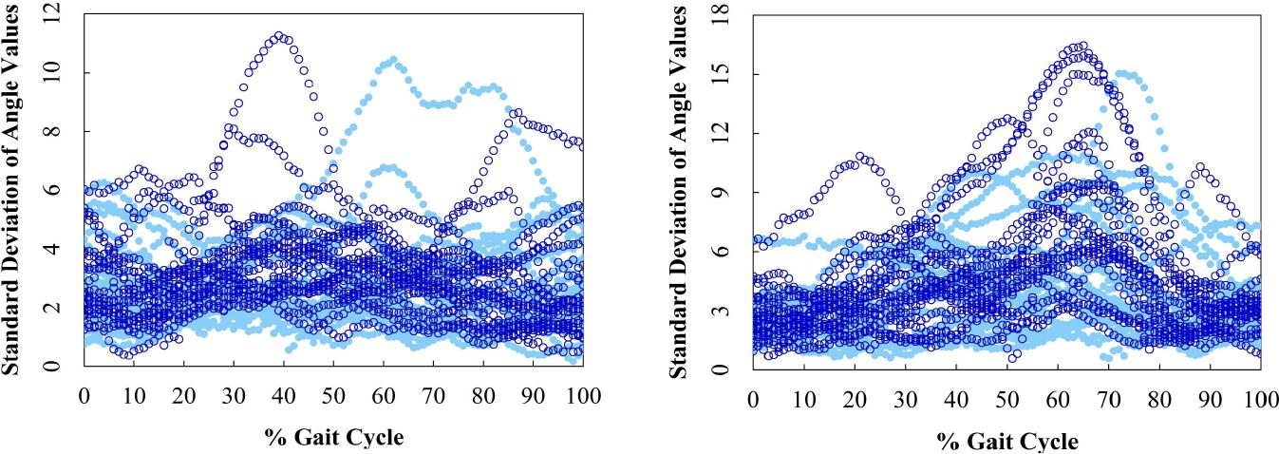
Intraindividual Variability: Upper Body Joints
A - Shoulder Joint B - Elbow Joint
Figure 5 – Upper Limb Standard Deviations

Slide 11
Intraindividual Variability: Lower Body Joints
A - Hip Joint B - Knee Joint C - Ankle Joint
Figure 6 – Lower Limb Angular Waveforms

Slide 12
Intraindividual Variability: Lower Body Joints
A - Hip Joint B - Knee Joint C - Ankle Joint
Figure 7 – Lower Limb Standard Deviations

Slide 13
RESULTS
Gait Utility in Identification
Intraindividual Variability
 |  | Interindividual Variability
Are characteristics of singular |  | How large are differences |  | Does the degree of intraindividual |  | Do differences between body
gait cycles represented in their |  | amongst gait cycles of the |  | variability influence differentiation |  | sides influence differentiation
respective mean waveforms? |  | same participant? |  | amongst individuals? |  | amongst individuals?
 | Shape |  | Standard Deviation
 |  |  |  |  | Fisher-pitman permutation tests
Synchronicity
Angle Values

Slide 14
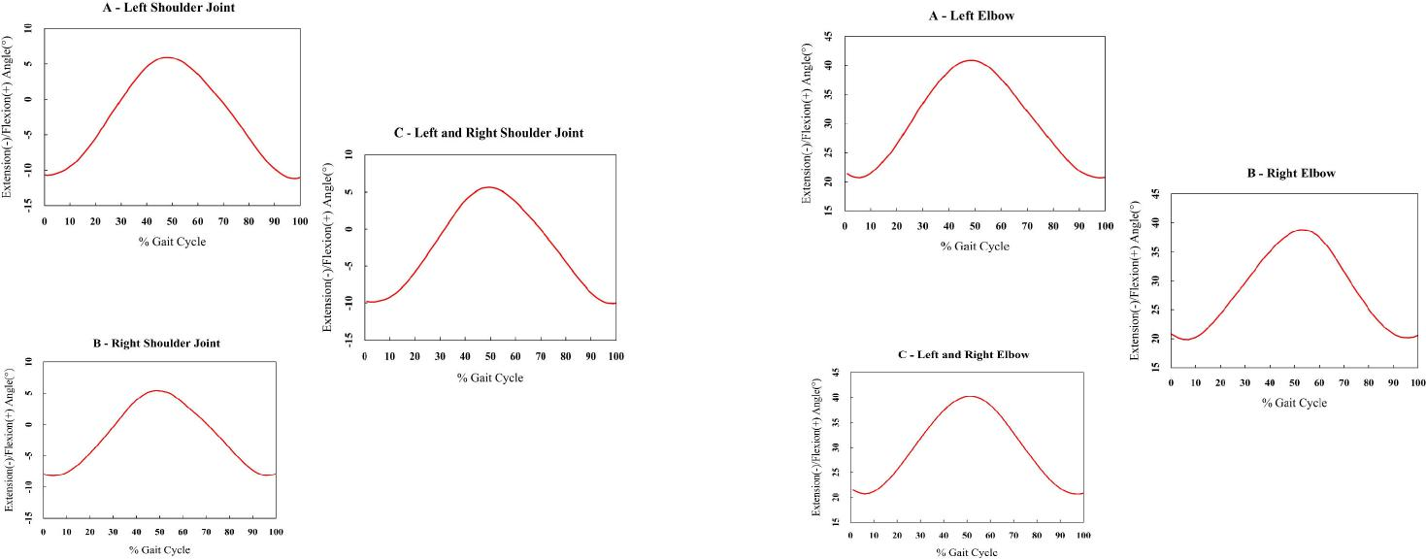
Interindividual Variability: Upper Body Joints
A - Shoulder Joint B - Elbow Joint
Figure 8 – Fisher-Pitman Permutation Tests in the Upper Body

Slide 15
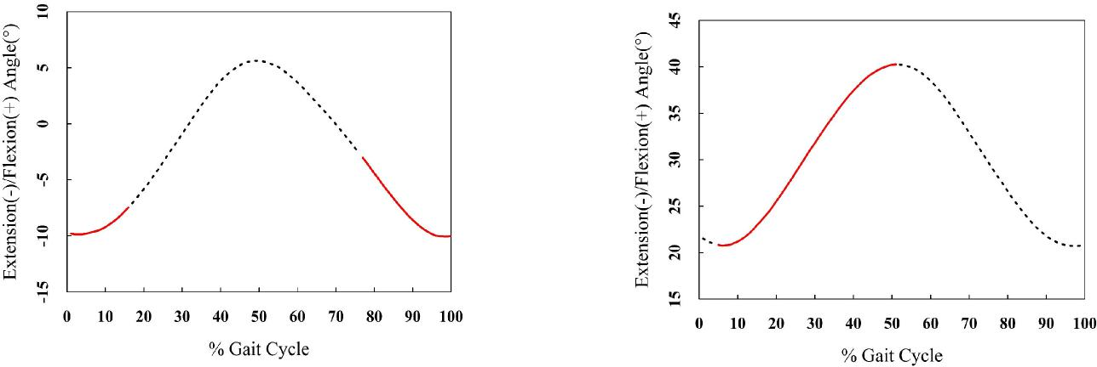
Interindividual Variability: Upper Body Joints
A - Shoulder Joint B - Elbow Joint
Figure 9 – Fisher-Pitman Permutation Tests Given Body Side in the Upper Limb

Slide 16
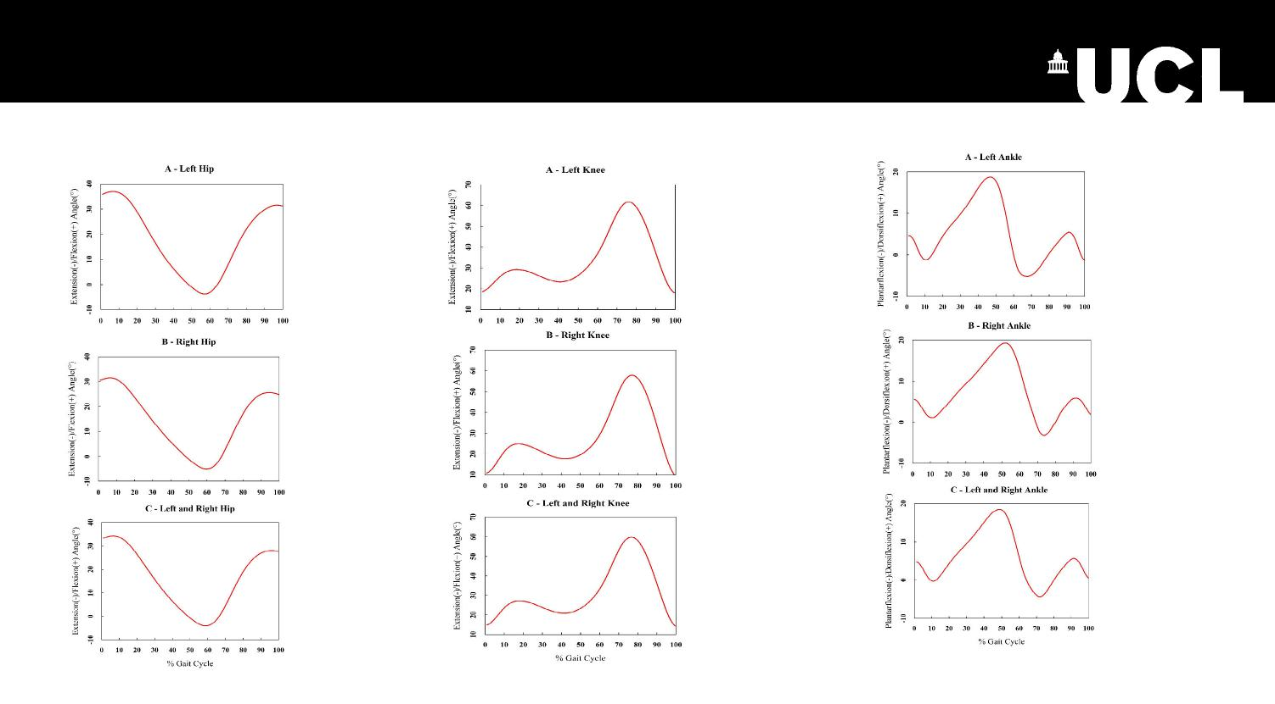
Interindividual Variability: Lower Body Joints
A - Hip Joint B - Knee Joint C - Ankle Joint
Figure 10 – Fisher-Pitman Permutation Tests in the Lower Limb

Slide 17
Interindividual Variability: Lower Body Joints
A - Hip Joint B - Knee Joint C - Ankle Joint
Figure 11 – Fisher-Pitman Permutation Tests Given Body Side in the Lower Limb

Slide 18
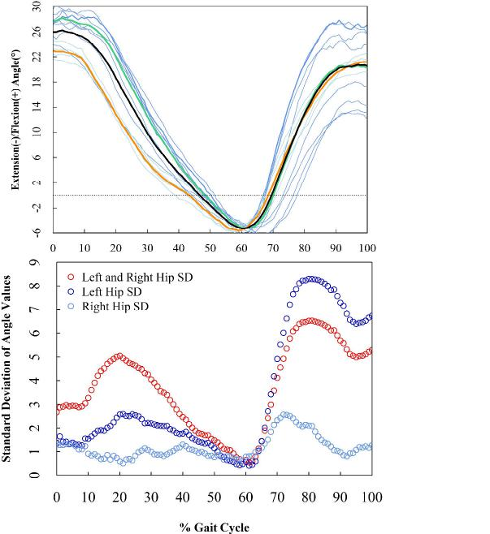
DISCUSSION & CONCLUSIONS
Figure 12 – Hip Data of Participant 3
Approximation of start and end of the gait cycle;
Location of the gait cycles within a walking activity;
Number of extracted gait cycles per experimental trial;
Inequality of extracted gait cycles per participant per body side and joint;
Uniformity of demographic characteristics;
Type of walking activity;
Anatomical model and processing;
Alternative approaches to dataset processing and analysis.
Left Hip Cycles Right Hip Cycles Left Hip Mean Right Hip Mean Total Mean

Slide 19
DISCUSSION & CONCLUSIONS
Intraindividual variability does not impact interindividual variability when examining unilateral sagittal plane movements thereby providing evidence for the claim of uniqueness and for the potential of gait for individualisation;
Gait uniqueness and the potential for individualisation are dependent on movement symmetry;
Interindividual variability is least affected by body side in the shoulder and ankle joints;
Interindividual variability is most affected by body side in the knee joint;
The first 20% of the gait cycle is the least recommended segment for individualisation.
+ Role and scope of forensic gait analysis;
Definition
Type of ‘walking’ activity
Features of interest
Concept of ‘gait cycle’
Implications
+ Code of practice amendments;
+ Hybrid approach to future methods;
+ Alternative applications and methods.

Slide 20
Supervisors
Dr. Carolyn Rando – UCL Institute of Archaeology
Prof. Ruth Morgan – UCL Department of Security and Crime Science
Acknowledgements
Dr. Herve Borrion – UCL Department of Security and Crime Science
Dr. Enrico Crema – University of Cambridge, McDonald Institute of Archaeological Research
Prof. Tamim Asfour – Karlsruhe Institute of Technology, Germany

Slide 21
THANK YOU!

Slide 22
References
Mandery, C., Terlemez, O., Do, M., Vahrenkamp, N. and Asfour, T. 2015. The KIT Whole-Body Human Motion Database. International Conference on Advanced Robotics (ICAR), 27-31 July 2015. Istanbul, Turkey. pp. 329 – 336. https://h2t.anthropomatik.kit.edu/pdf/Mandery2015a.pdf (accessed October 16, 2020).
Mandery, C., Terlemez, O., Do, M., Vahrenkamp, N., and Asfour, T. 2016. Unifying representations and large-scale whole-body motion databases for studying human motion. IEE Transactions on Robotics, 32(4):796-809.
Terlemez, O., Ulbrich, S. and Mandery, C. 2014. Master Motor Map (MMM) – Framework and toolkit for capturing, representing, and reproducing human motion on humanoid robots. IEEE-RAS International Conference on Humanoid Robots (Humanoids). 18-20 November. Madrid, Spain. https://h2t.anthropomatik.kit.edu/pdf/Terlemez2014.pdf (accessed April 25, 2020).

