Slide 1
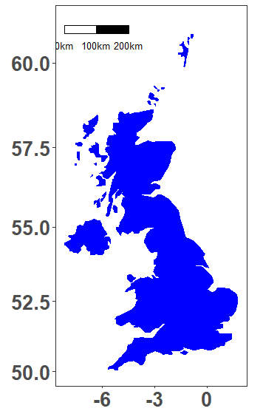
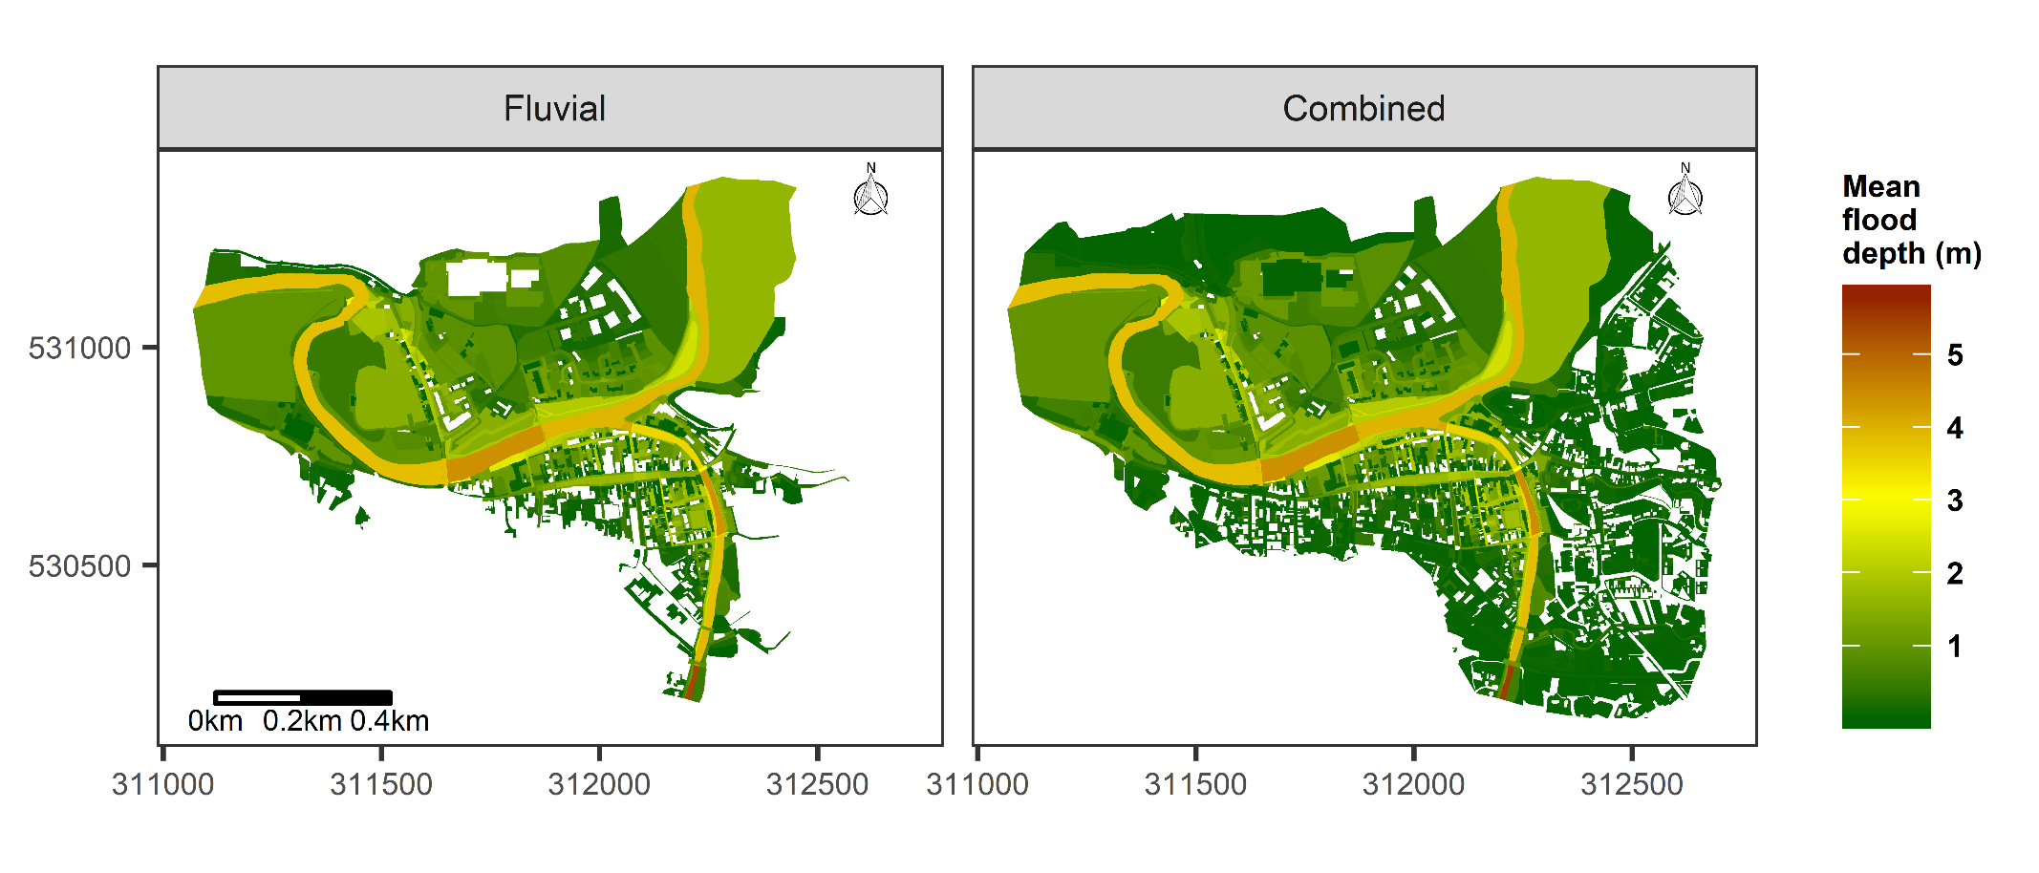
Remote sensing in flood modelling
1. Published work (Remote Sensing Journal) - Effect of different flood types - 2015 Cockermouth flood
Fluvial + Pluvial

Slide 2
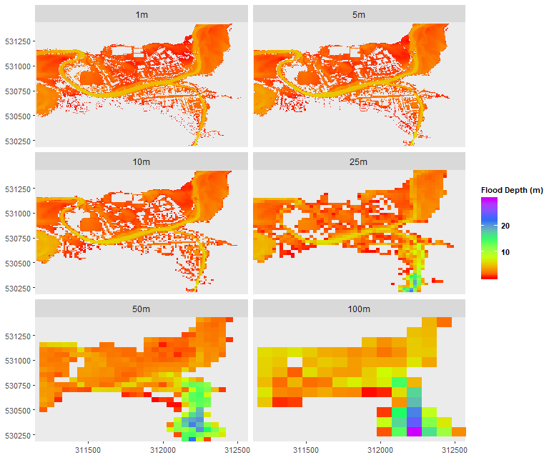
Remote sensing in flood modelling
2. Current work - Effect of DEM resolution in flood modelling –2015 Cockermouth flood

