Slide 1
Securely store your supporting data on CORD
While making it discoverable and citable

Slide 2
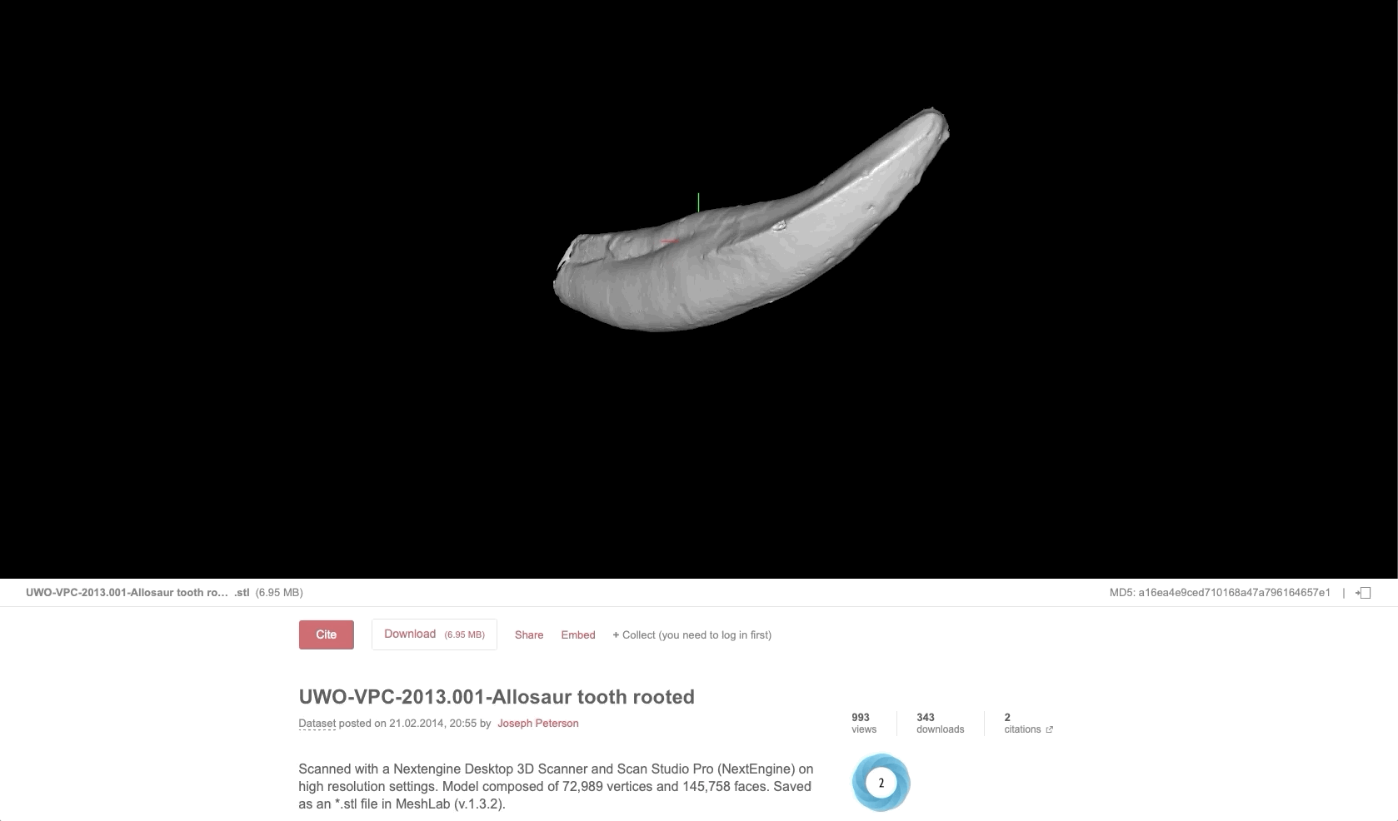
Figshare, the software used for CORD, is a cloud-based platform for securely storing your research data while making it discoverable and citable.
Notes:
Figshare is a cloud-based system for storing your supplementary material. Material stored on Figshare is accessible anytime and anywhere.
Supplementary material stored on Figshare is discoverable on search engines including Google Scholar and Google Dataset Search.
Public material is assigned a Digital Object Identifier (DOI) for citing and persistence. Keep track of where your material has been cited alongside other usage statistics.

Slide 3
Why CORD?
✔
Store your outputs in any file format
Securely collaborate with researchers from other institutions
Get a citable DOI for public outputs
Demonstrate impact with Altmetrics, usage metrics, & citation counts
Open Access funder compliance
Help others discover your outputs on Google Scholar
✔
✔
✔
✔
✔

Slide 4
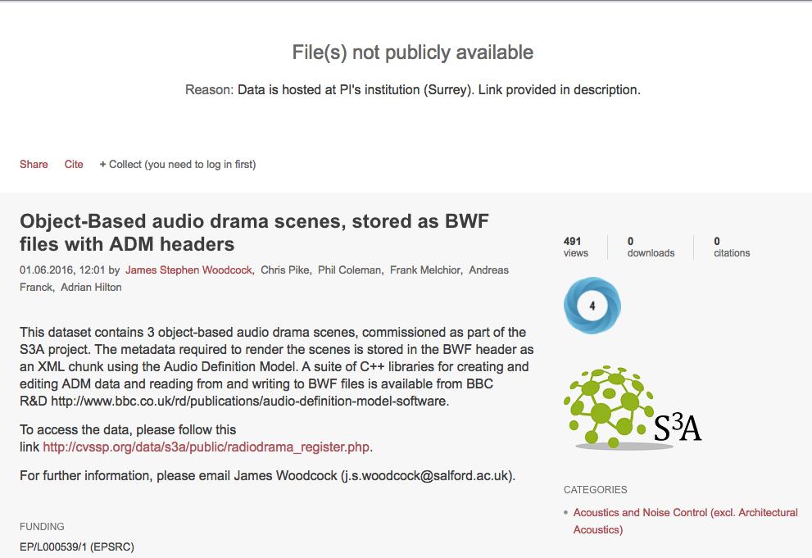
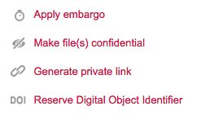
As open as possible, as closed as necessary
Your research outputs should be as open as possible, but control over access is important.

Slide 5
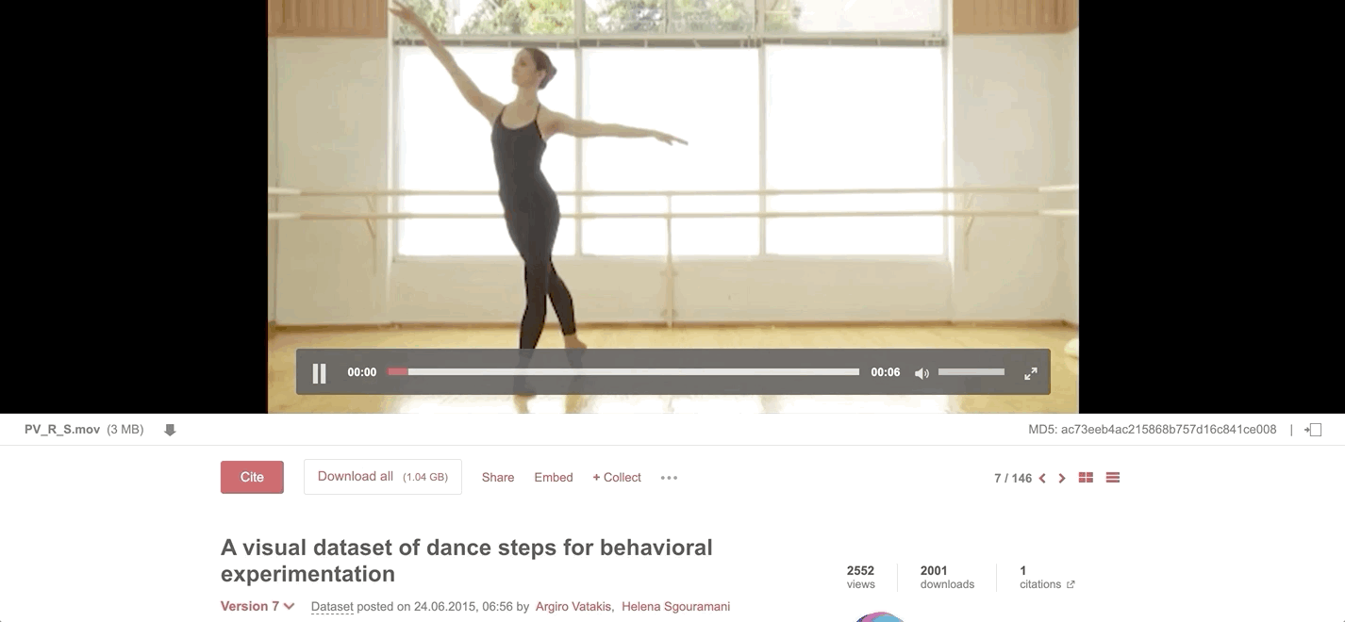
What can you upload to CORD?
We accept any file format and aim to preview files in the browser.
Vatakis, Argiro; Sgouramani, Helena (2015): A visual dataset of dance steps for behavioral experimentation. figshare. Dataset. https://doi.org/10.6084/m9.figshare.1453169.v7

Slide 6
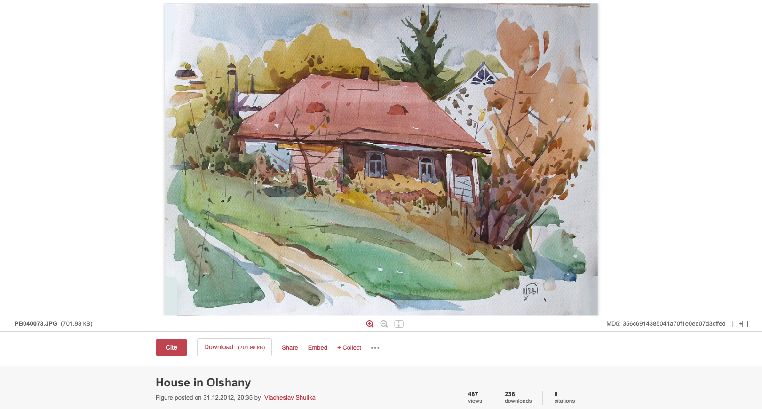
Images
Shulika, Viacheslav (2012): House in Olshany. figshare. Figure.
https://doi.org/10.6084/m9.figshare.105655.v1

Slide 7
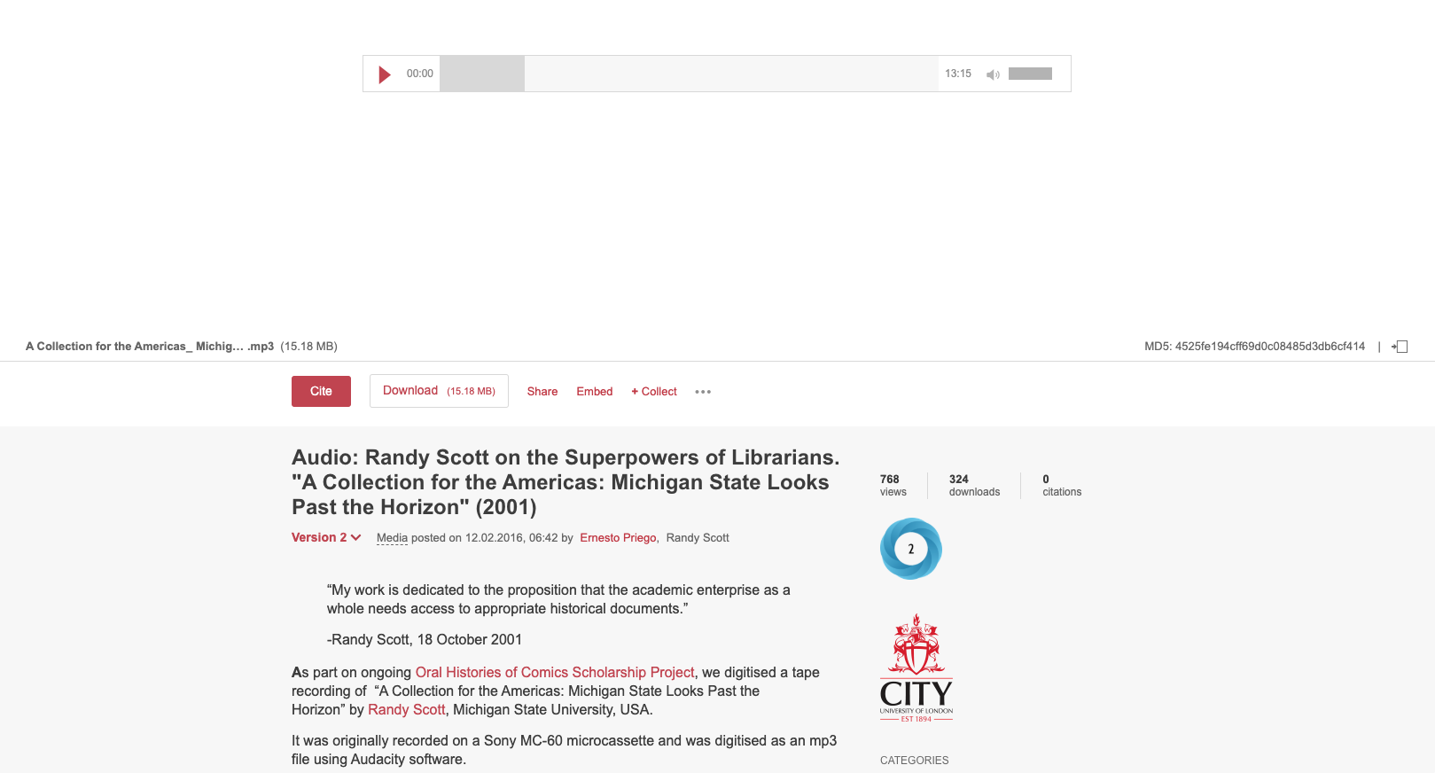
Audio
Priego, Ernesto; Scott, Randy (2016): Audio: Randy Scott on the Superpowers of Librarians. "A Collection for the Americas: Michigan State Looks Past the Horizon" (2001). City, University of London. Media.
https://doi.org/10.6084/m9.figshare.2099164.v2

Slide 8
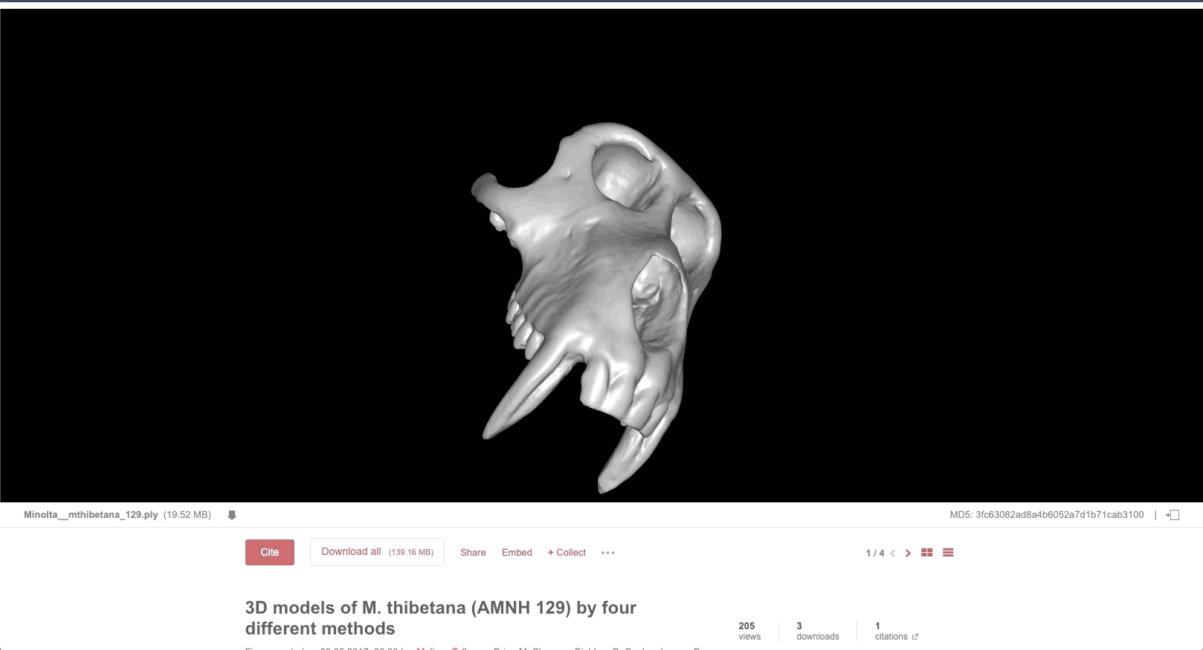
3D files
Tallman, Melissa; Shearer, Brian M.; Cooke, Siobhan B.; Halenar, Lauren B.; Plummer, Jeannette; Reber, Samantha; et al. (2017): 3D models of M. thibetana (AMNH 129) by four different methods. figshare. Figure.
https://doi.org/10.6084/m9.figshare.4989656.v1

Slide 9
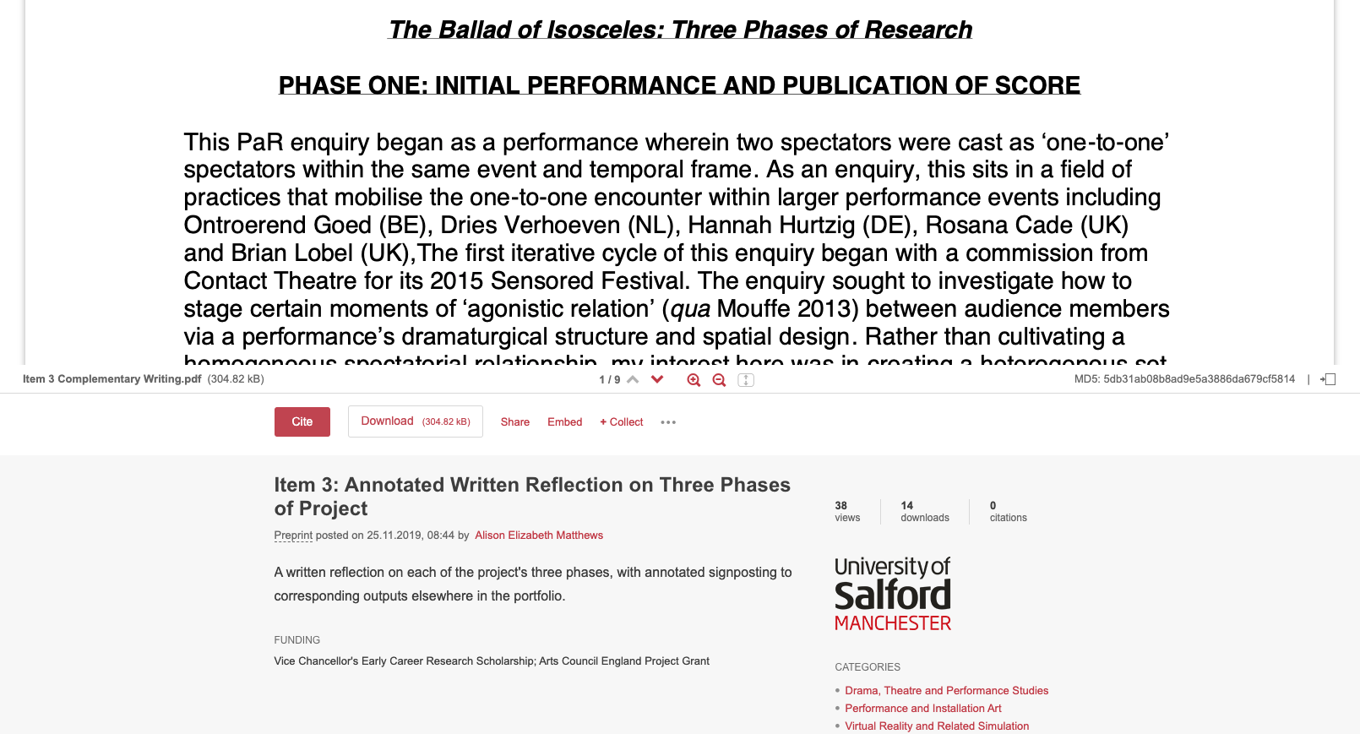
Papers/documents
Matthews, Alison Elizabeth (2019): Item 3: Annotated Written Reflection on Three Phases of Project. figshare. Preprint. https://doi.org/10.17866/rd.salford.11087969.v1

Slide 10
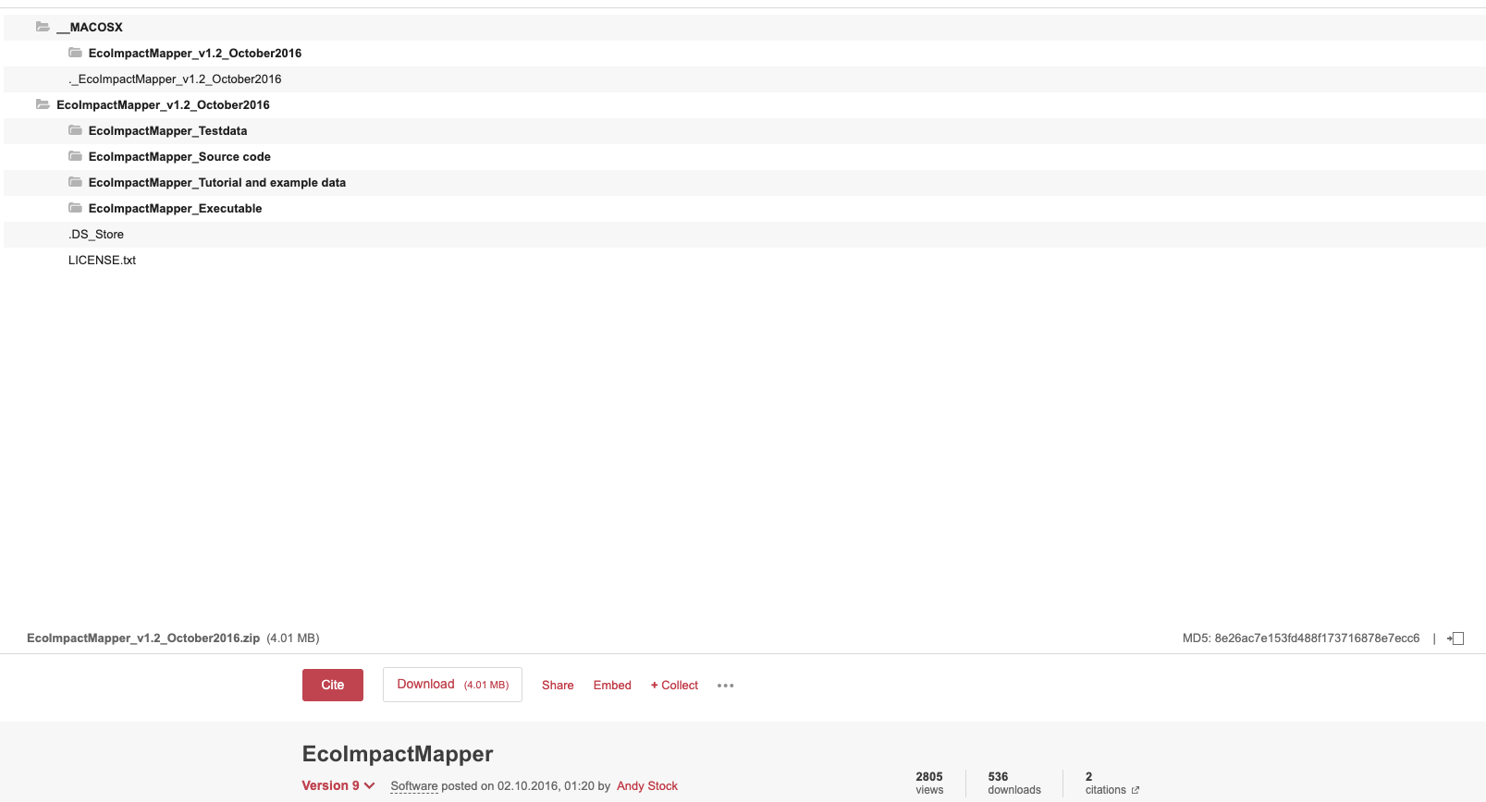
Code
Stock, Andy (2016): EcoImpactMapper. figshare. Software.
https://doi.org/10.6084/m9.figshare.1519342.v9
Notes:
Software code is the most-cited item type on Figshare (likely because it’s so reusable).

Slide 11
Posters
Brown, Alex; Warton, David; Andrew, Nigel; Binns, Matthew; Gerry Cassis; Gibb, Heloise (2014): POSTER: The fourth-corner solution: using predictive models to understand how species traits interact with the environment. figshare. Poster. https://doi.org/10.6084/m9.figshare.900387.v1

Slide 12
Presentations
Skeptic, Neuro (2015): P-Hacking: A Practical Guide. figshare. Presentation.
https://doi.org/10.6084/m9.figshare.1422034.v1

Slide 13
Projects
→ Upload items to the project
→ Add collaborators or viewers. Invite institutional colleagues, figshare.com users, or invite people with no Figshare account to join your project
→ Keep it private or make it public
Notes:
Usually used for on-going, collaborative work.

Slide 14
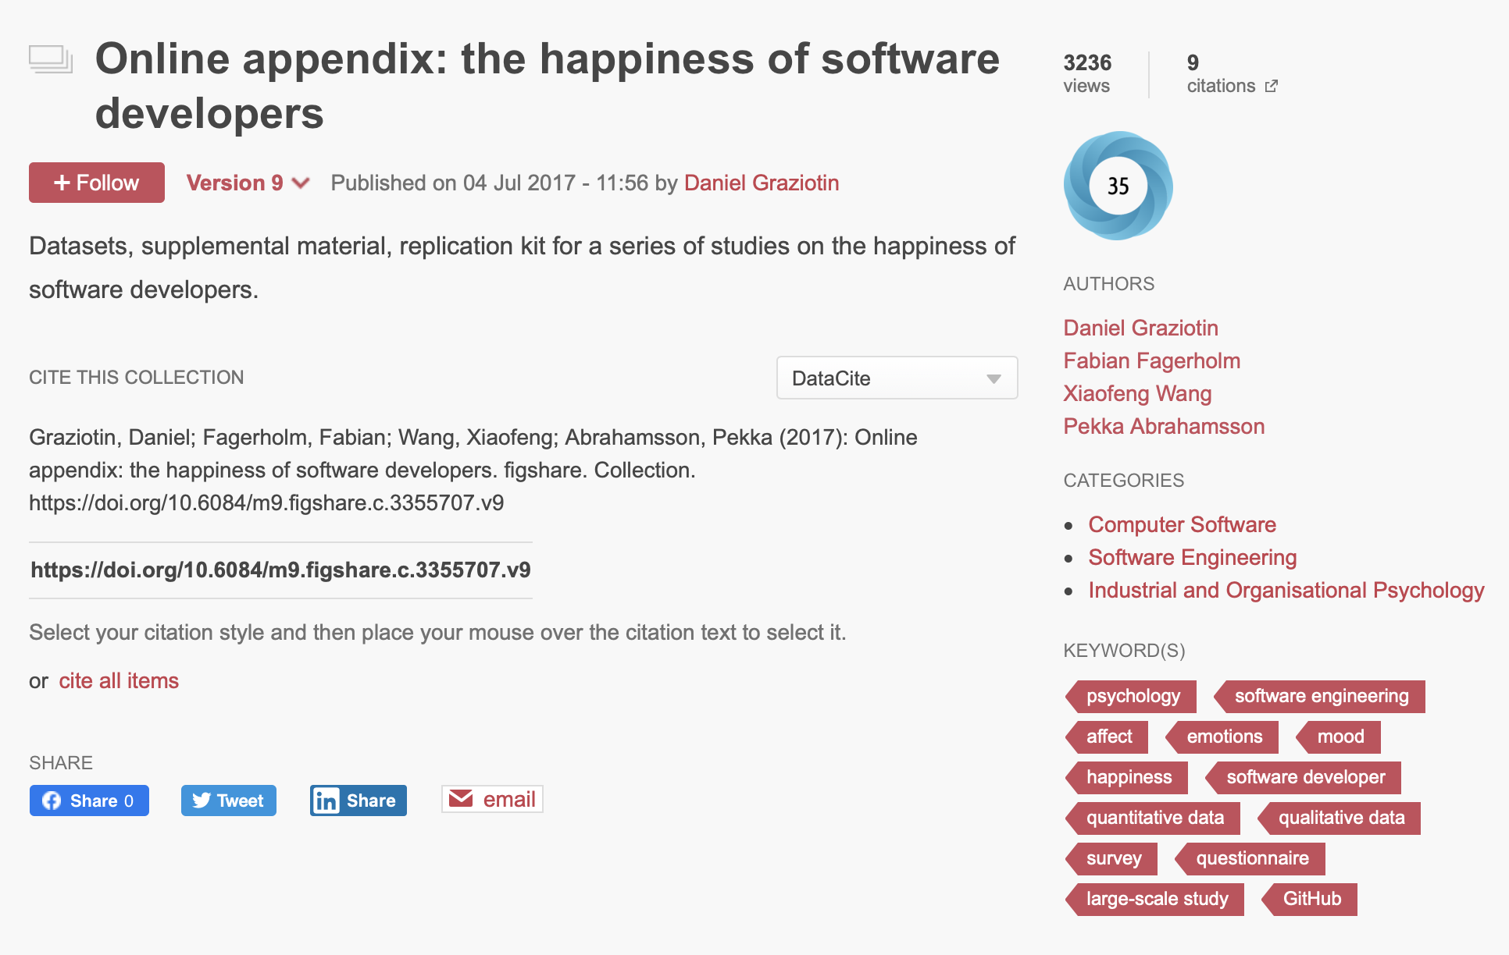
Collections
✔
Pull from your data or public data
Use to showcase your data
Get a citable DOI for the collection
Supports versions
Tracks Altmetrics, usage metrics, and citations
✔
✔
✔
✔
Graziotin, Daniel; Fagerholm, Fabian; Wang, Xiaofeng; Abrahamsson, Pekka (2017): Online appendix: the happiness of software developers. figshare. Collection.
https://doi.org/10.6084/m9.figshare.c.3355707.v9
Notes:
Different ways of grouping data

Slide 15
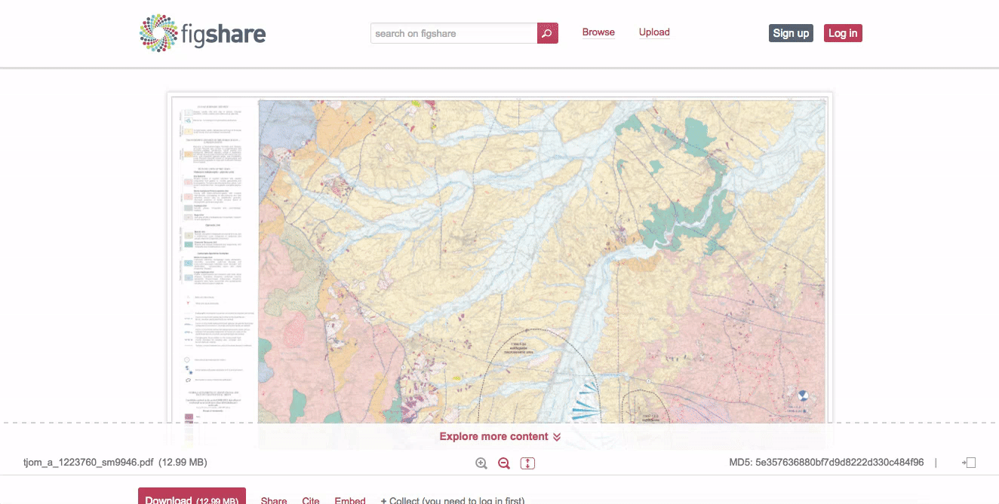
Altmetric
Notes:
Sister company to Figshare that tracks alternative metrics (mentions in news outlets, blog posts, social media, and more). https://www.altmetric.com/
Altmetric donuts automatically appear when there is attention on your output(s).

Slide 16
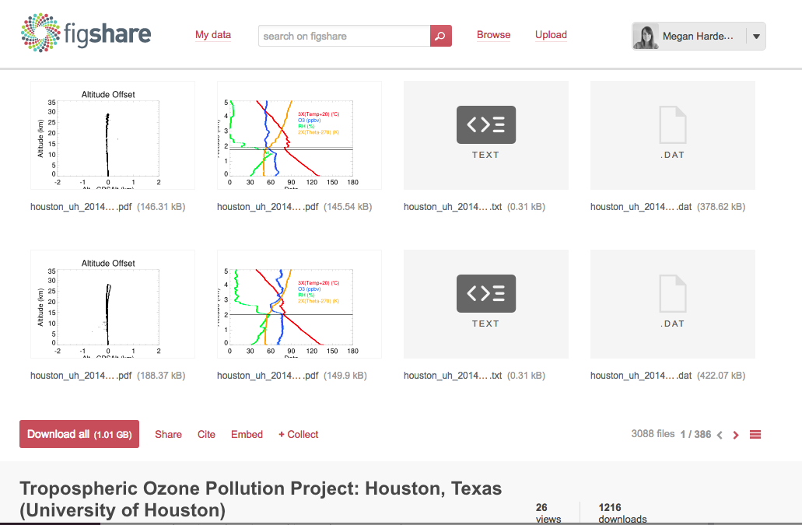
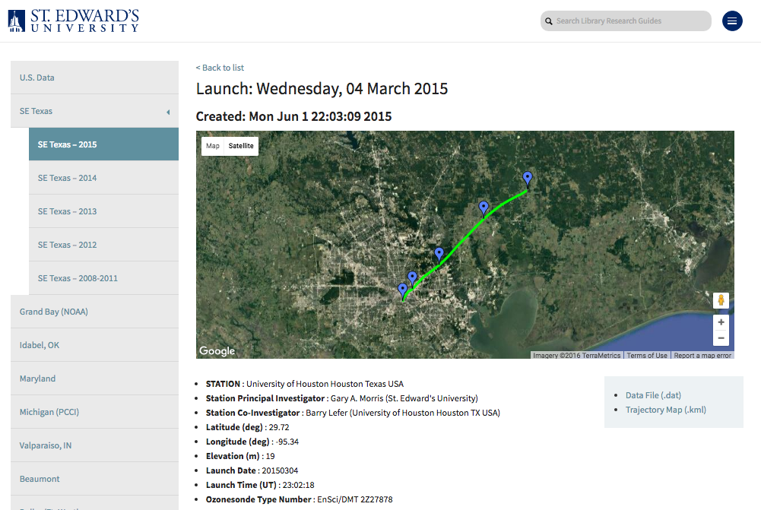
Figshare API
Notes:
Programmatically push and pull outputs to and from Figshare with the API. https://docs.figshare.com/
This example shows raw data store in Figshare and displayed on a Wordpress institutional repository using the API.

Slide 17
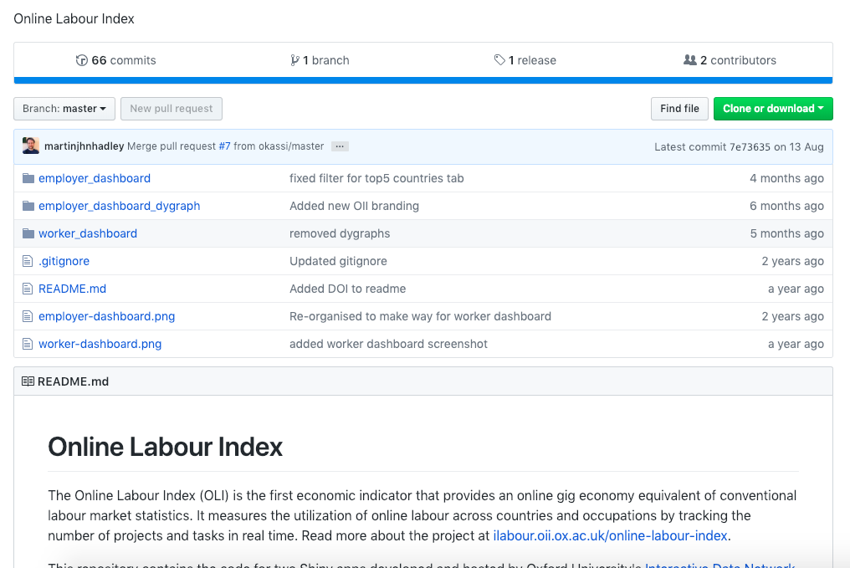
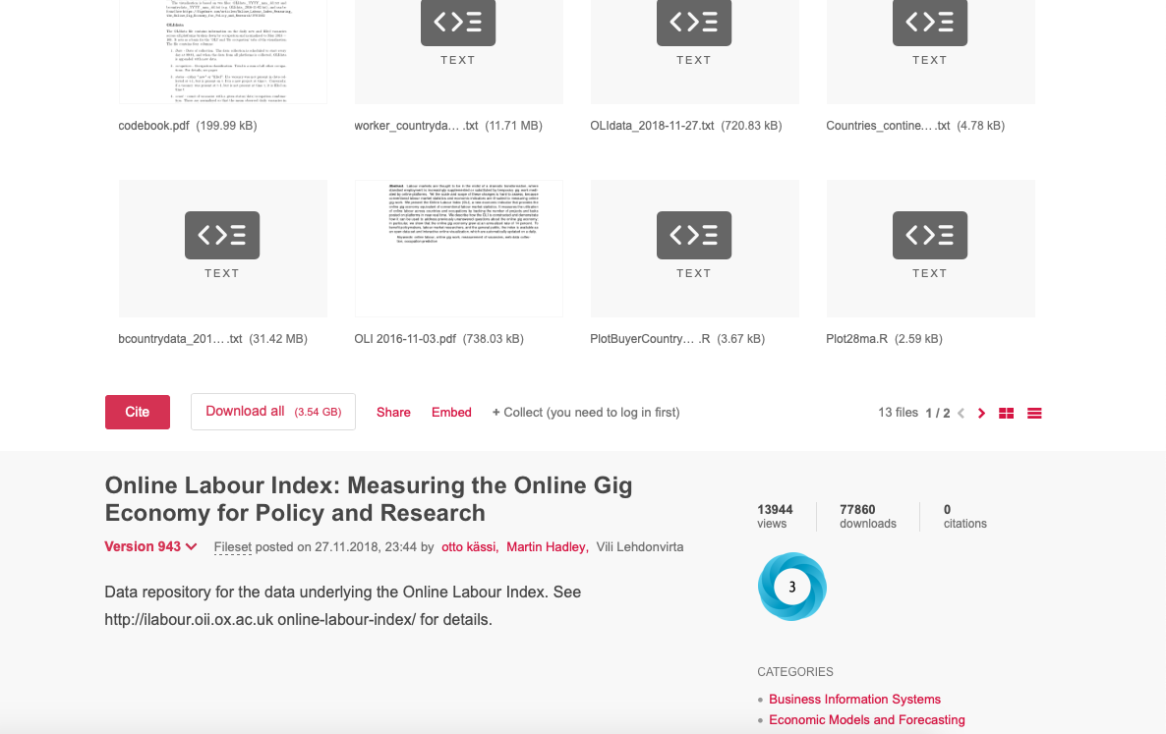
GitHub integration
Notes:
Take a snapshot of code using the GitHub integration. https://knowledge.figshare.com/articles/item/how-to-connect-figshare-with-your-github-account-1

Slide 18
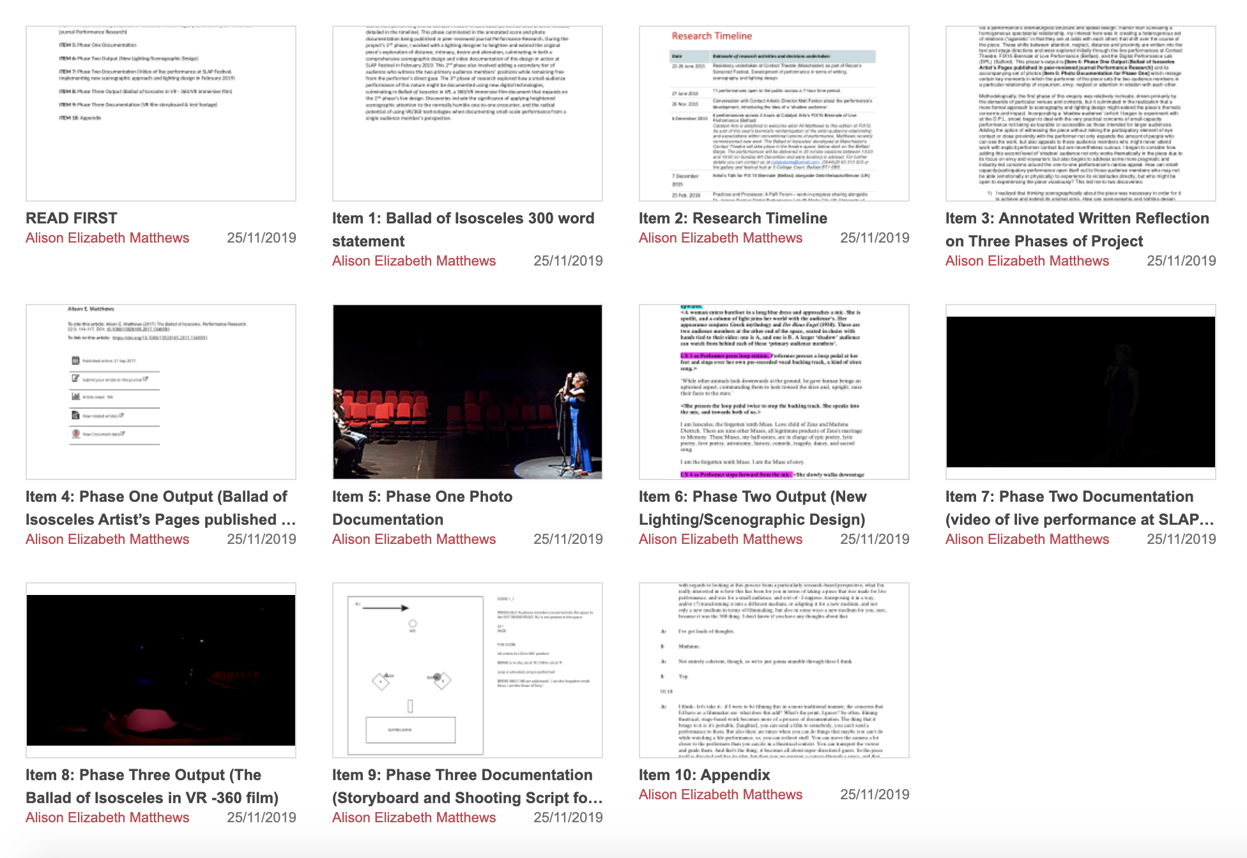
Funder compliance
Matthews, Alison Elizabeth (2017): Ballad of Isosceles. figshare. Collection.
https://doi.org/10.17866/rd.salford.c.3901567.v2
Notes:
This particular collection is for REF (UK) and includes data plus documentation (research timeline, annotated written reflection).

Slide 19
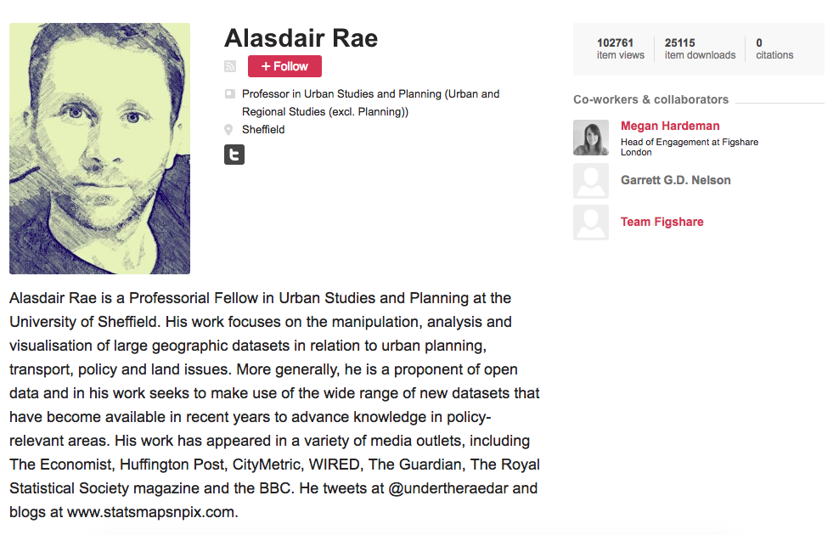
Impact case study: Alasdair Rae
Notes:
Researcher at University of Sheffield. Full case study here: https://figshare.com/articles/The_impact_of_sharing_supplementary_datasets_and_speaking_outside_the_echo_chamber_Urban_Studies_and_Planning/4654045

Slide 20
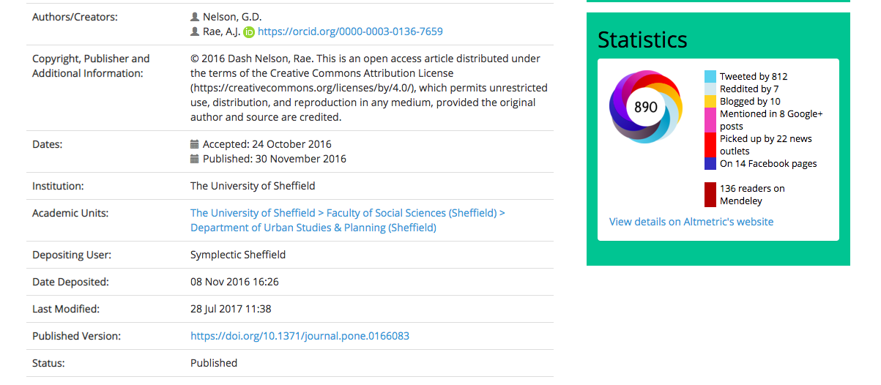
The background
In 2015, Alasdair began a piece of analysis looking at census travel to work data in the U.S.
He published the data on Dropbox and put the working paper on the White Rose Repository at The University of Sheffield.
Notes:
Researcher at University of Sheffield. Full case study here: https://figshare.com/articles/The_impact_of_sharing_supplementary_datasets_and_speaking_outside_the_echo_chamber_Urban_Studies_and_Planning/4654045.
Sharing his data garnered interested from Garrett Nelson. Did further analysis and published their research on Figshare.

Slide 21
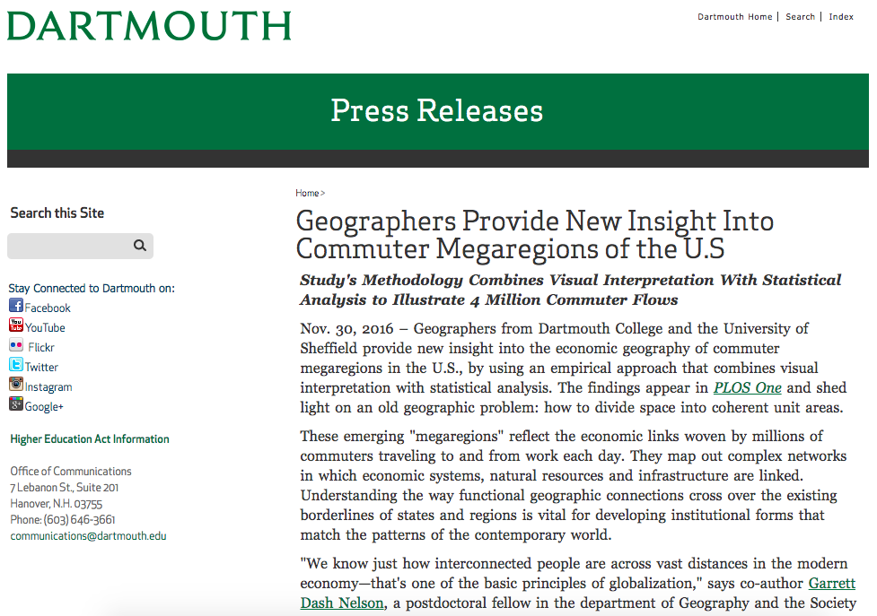
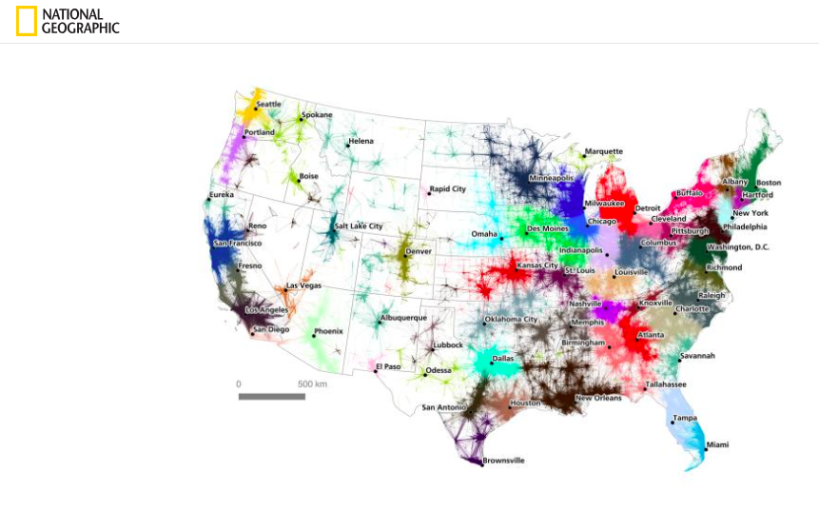
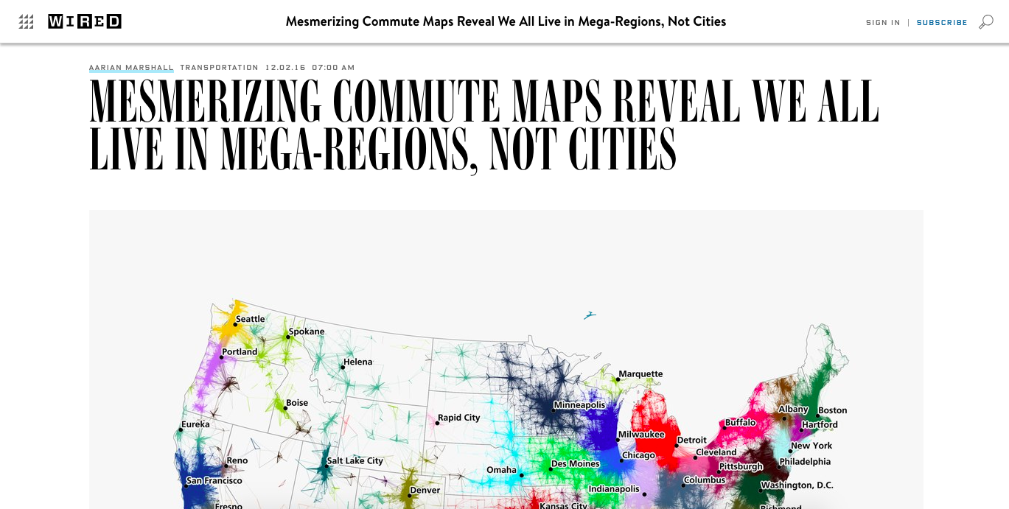
The background
Notes:
Picked up in the press.

Slide 22
Alasdair’s thoughts on the impact of sharing his data
“Had we not been so open with sharing our data, I think we would have had a lot of people emailing us asking for the data and information on how we gathered it. I’ve had a lot of requests from journalists or people in different parts of the U.S. saying how they felt this data verified what they thought about commuting.
Getting all of our data up there has actually saved a lot of time and effort in the end. The exposure is good, as well: people can spot anything that’s wrong and we can easily correct it.”
Notes:
Started sharing on Figshare and picked up in the press.

Slide 23
Read more about the case study
More information on:
Why you should publish your data alongside your publications
How Alasdair and Garrett promoted their data after they shared it on Figshare
How they decided on the file formats and documentation to include in their Figshare fileset
https://doi.org/10.6084/m9.figshare.4654045

Slide 24
Thank you!
Questions?
researchdata@cranfield.ac.uk

