Slide 1
RDM 2: Writing a data management plan
Georgina Parsons,
Research Data Manager
April 2019

Slide 2
Prerequisites and materials.
Prerequisites: You should have attended “RDM 1: Introduction”, via workshop/webinar/VLE. (See DATES or RDM VLE module.)
Materials: Today’s slides are at DRCD intranet site > Session resources.

Slide 3
Session plan.
1.
DMPs in theory: what, whey, how, when?
2.
Using DMPonline: introduction/signing up.
3.
Draft your own DMP, and final recap.

Slide 4
DMPs in theory: what are they?
1.
A document setting out how you will approach various aspects of RDM during your project.
Usually one to three pages.
A living document that you develop throughout your project and discuss at review meetings.
Notes:
Now a what-why-how of DMPs.

Slide 5
DMPs in theory: why do we write them?
1.
To ensure compliance with requirements.
To ensure data is handled appropriately throughout a project.
To save you time.
Another publication to your name? (See the DMPTool’s public DMPs and DMPs in the RIO journal.)
Notes:
1. Mandatory for doctoral students registered from 1 October 2016. It’s a document that’s on the checklist for supervisor review meetings, alongside your risk assessment etc..
2. And that’s why they’re required by funders and institutions – because they want assurance that you’re planning the appropriate procedures and security.
3. They are to benefit you and plan research efficiently and get support early on where needed, so don’t put them off or disregard them.
4. You get a DOI, citations, metrics… useful to see what others have done, PhD examples in the RIO journal at http://rio.pensoft.net/articles.php?id=8664&instance_id=3072860
DMPTool’s public DMPs are not peer reviewed; DMPs in the RIO journal have optional peer review.

Slide 6
DMPs in theory: how do we write them?
1.
Cranfield researchers should use DMPonline:
We’ll sign up to https://dmponline.dcc.ac.uk/.
See also our Using DMPonline pdf.
Occasionally you could use a Word template:
Intranet > Research > Research Data Management > Data management plans > Choose a template: EPSRC, STFC, BBSRC, ESRC, H2020, NERC, generic.
Notes:
Benefits of DMPonline: sharing, collaboration, compliance monitoring, submit for review, can also export and publish.

Slide 7
DMPs in theory: when do we write them?
1.
You must write a DMP before starting to collect data.
For doctoral students, the DMP is on the checklist at supervisory review meetings.
The DMP should be regularly reviewed and updated at key points, e.g. if you identify a new dataset you will create/use.
Notes:
DMPs are mandatory for doctoral students registered from 1 October 2016. The first draft must be before data collection but this may not be for your initial review.
At supervisory or project review meetings, the DMP should be checked over to see if there are any questions/concerns to address. They can always be referred to me!
Staff: in research, increasingly required when submitting a proposal for funding. E.g. all UKRI councils except EPSRC want one submitted with your proposal; H2020 want a full plan as a deliverable at month 6. Your plan should then be reviewed at each project review meeting to make sure everything’s on track and address any concerns.

Slide 8
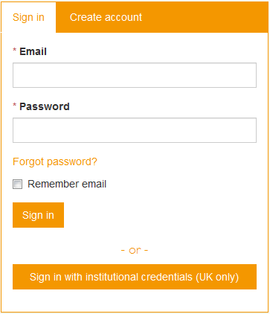
Using DMPonline: accessing and signing up.
2.
Go to https://dmponline.dcc.ac.uk/ and choose ‘sign in with institutional credentials’.
Enter your Cranfield username and password.
The first time you do this, you need to fill in the form for a new account. Although you must enter a password, you will sign in using institutional credentials in future.
Notes:
When you have a split screen option choose ‘create new account’ on the right.

Slide 9
Using DMPonline: creating a new plan.
2.
Choose ‘Create plans’ from the menu bar at the top.
Enter your research project title.
Choose Cranfield University as your organisation.
Tick the ‘no funder’ box (or choose a funder if relevant).
In this session, we are using the ‘no funder’ template.

Slide 10
Using DMPonline: plan menu options.
2.
Project details: add any further administrative details e.g. grant number or second contact for your plan.
Plan overview: this provides an outline of what the DMP will cover.
Write plan: this is where you write the actual DMP!
Share: publish your plan, add collaborators (e.g. your supervisor), and request my feedback here.
Download: download your DMP in csv/html/pdf/text/docx format.

Slide 11
Using DMPonline: writing your plan.
2.
Choose ‘Write plan’ and you’ll see eight expandable sections.
In each section, you will have one or more questions to answer.
Guidance is provided on the right-hand side in tabs (DCC and Cranfield guidance is separate).
I’ll now talk through the screen where you answer the questions.
Notes:
If you chose a funder, the template will look different, but the same content should be covered.
Now live demo in DMPonline – talking through the screen for each question, noting answer box, guidance to the right from DCC and CU, and comments area.

Slide 12
Draft your own DMP.
3.
You now have time to draft your own DMP.
I’ll come round for questions and guidance.
When your draft is done, submit it for review (in the ‘share’ tab) and/or share it with your supervisor.
Notes:
NB Generally plans are checked by me, or you can go through the guidance by each question again and make sure it is covered.
Some plans can also be evaluated on your own using a rubric where this is available – namely for specific funder templates used in funding bids, available on the DMP intranet page.
CC-BY image from Flickr by Caleb Roenigk https://www.flickr.com/photos/crdot/6855538268

Slide 13
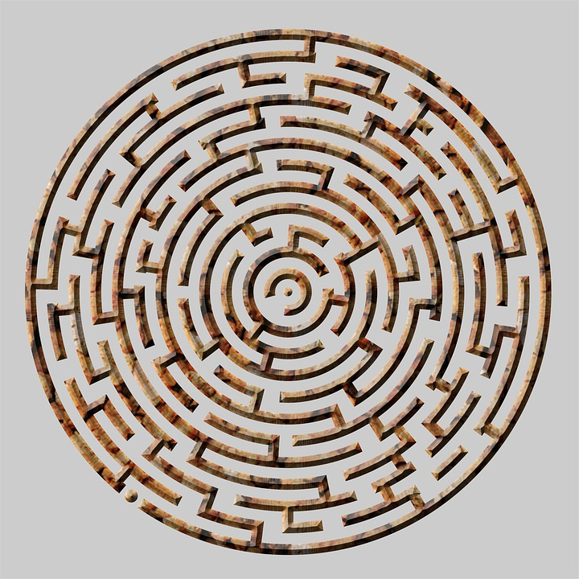
Final recap: quiz.
3.
Go to https://socrative.com > login > student login
Room name: PARSONS7469 > join
Notes:
CC0 image from maxpixel.

Slide 14
Further help and information.
Intranet: Research > Managing your Research > Research Data Management (http://bit.ly/RDM-home)
Personal support: Georgina Parsons, 01234 754548 (x4548), g.l.parsons@cranfield.ac.uk, researchdata@cranfield.ac.uk. Tue-Thur.
Training: DATES for workshops/webinars; full RDM module on VLE at https://moodle.cranfield.ac.uk/RDM
Notes:
Do email me about any draft plans or arrange a one-to-one; I can review plans or help liaise to resolve any questions/concerns highlighted by the DMP (e.g. around storage, consent, IP, etc).
You can also chat to me at our Research Support Stand in the Slim Atrium (12:00-14:00 second Thursday of the month).

